Slide 1
Work Experience

Slide 2
60% Of Jobs are never advertised

Slide 3
Step 1. Think about you
Analyse your strengths and weaknesses.
If you know what you are good at and what you aren't so good at, it will be easier for you to find a placement which will not only be fun, but help you in future life.
Do not choose a job that you don't understand just to get a placement. Choose a company which specialises in something interesting to you.

Slide 4
Step 1:
Decide the sector that you would like to work in – but be realistic!
Sports
Local sports provider / leisure centre
Gym
PE teacher……….
Doctor
Wayfinder at Torbay Hospital
Nursing Home
Pharmacy
Other practices such as optician, dentist, chiropody etc.
Notes:
Work Experience week will be held in February next year, that is why we are preparing early. It is to ensure that this important week is not interrupted by any exams you may have.
I would just like to go through a few things with you about why work experience is important and why you must consider your future very carefully as it will impact on your adult life very much.

Slide 5
Step 2. Where are the Employers?
Network
Talk to people you know. The more people who know you are looking for work the better. Even if they don’t know about a job themselves, they may know somebody who does. Have a chat with family, friends, teachers, Facebook friends and anybody else who knows you.

Slide 6
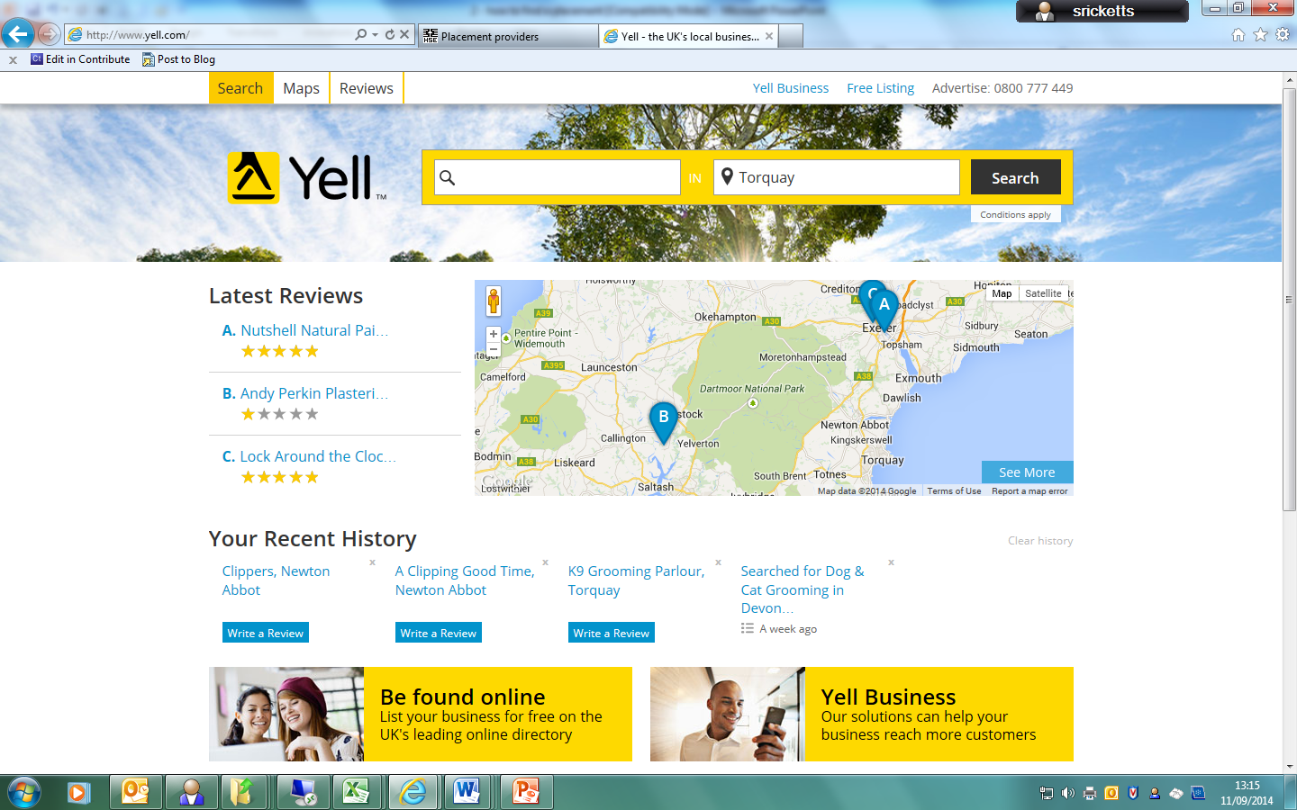
Google Search/ Yell.com

Slide 7
Contacting Employers
Research
Do some research on the company and find out who to address the letter to, making it more likely to be looked at.
Phonecall
Don't be afraid to ring up the company you are opting for a place with, especially if you have good speaking skills and are able to talk them into giving you a placement.
Write
If you aren't confident with ringing them, you might want to write them a letter asking if they take work experience students and if they can accept you.
Make sure it is Professional have it checked by careers@paigntonacademy.org
Example CVs and letters are on the school website.
Visit
Visit them. Dress the part. When going for an interview, you'll need to dress according.

Slide 8
Notes:
What will you wear?
Have you spoken to your employer? What are you expected to wear? Are you working indoors or outside? Do you need to be smart? Do you need to take spare clothes? If you need help securing the correct uniform talk to your school and your parents.

Slide 9
What to talk about
Consider your intended career path.
If you know what job you want to go into, try hard to get some work experience in that area. When you apply to them, you can impress on them how well that line of work is suited for you, and how much you want to go into it.
If you are unsure as to what career you will have in the future talk about the key skills you wish to develop.
In a job interview, the employer will ask the questions, not you.
An employer may be looking to give you an actual job if you perform well during the work experience, so show them your best!

Slide 10
Keep trying
If you get turned down for a placement, don't worry and most certainly don't lose hope. Keep searching until you find one that's right for you.

Slide 11
In short…
Choose wisely
You may need to write a good letter and CV
Learn to use your contact network
Be persistent
A clean online presence

Slide 12
Once you have an employer
Ask the Employer to complete the employer details form
Parent completes the consent form
Return BOTH Forms in the envelope to reception.

Slide 13
What if I am unable to secure a placement?
If you do not manage to secure a placement Mrs Hay will do her very best to help you. We cannot guarantee it will be in your chosen industry.
Employers are more likely to say Yes to a student!

Slide 14
Still Unsure…
If you still aren't sure about where to go, ask Mrs Hay for help.
Or in the holidays email: careers@paigntonacademy.org

Slide 15
Notes:
Don’t forget to say thank you.
At the end of you work experience or even the week after don’t forget to send your employer a thank you letter. Share with them the skills you have learnt. It’s a good way of staying in touch and who knows, in a couple of years you might be working for them full time.

Slide 16
OWN FIND FORMS/ PARENT CONSENT
30th September

Slide 17
https://business.linkedin.com/talent-solutions/blog/2015/09/the-funniest-job-interview-answers-of-all-time
http://www.youtube.com/watch?v=sfkjvagVsRI

